Slide 1
Unit 3 Chapter 1A
BIVARIATE DATA

Slide 2
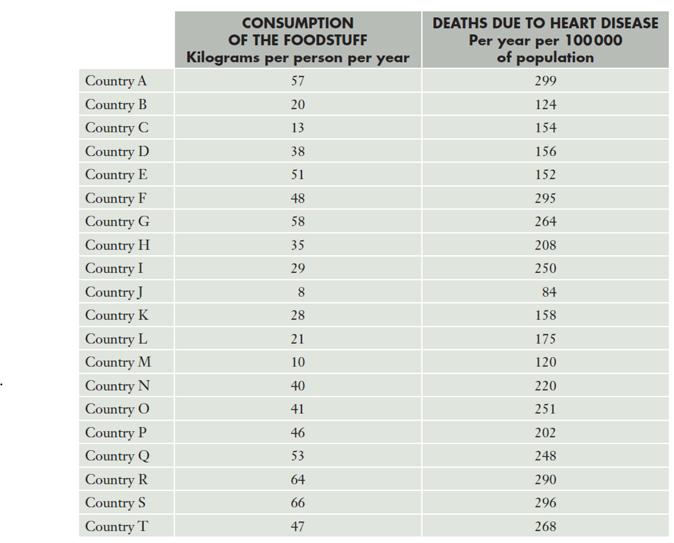
Unit 3 Chapter 1A
A statistician is asked to investigate whether countries with higher levels of consumption of a particular type of food had higher rates of heart disease deaths.
What do you think?
This situation involves two variables:
Consumption of one type of food
And death rates due to heart disease
As we are investigating two different variables, we now have bivariate data.

Slide 3
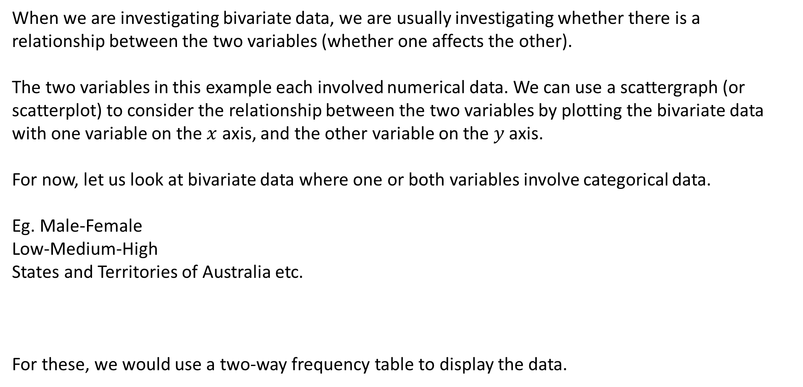
Unit 3 Chapter 1A
When we are investigating bivariate data, we are usually investigating whether there is a relationship between the two variables (whether one affects the other).
The two variables in this example each involved numerical data. We can use a scattergraph (or scatterplot) to consider the relationship between the two variables by plotting the bivariate data with one variable on the $x$ axis, and the other variable on the $y$ axis.
For now, let us look at bivariate data where one or both variables involve categorical data.
Eg. Male-Female
Low-Medium-High
States and Territories of Australia etc.
For these, we would use a two-way frequency table to display the data.

Slide 4
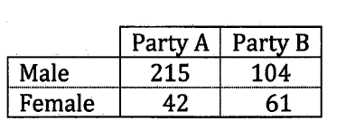
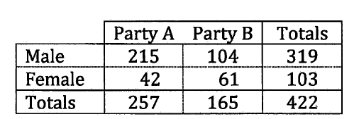
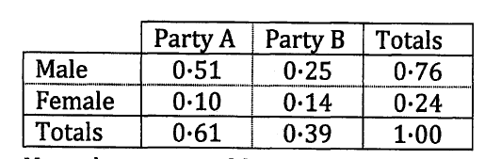
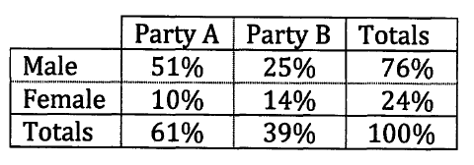
Unit 3 Chapter 1A
The number of male and female MPs from two major political parties are shown in the table on the right.
Observations we could make include:
A and B each have more male MPs than female MPs
B has less MPs than A overall but has more female MPs than A
It might be clearer if the entries were given as proportions or
percentages of the total (422).
Now we can easily state:
51% of all MPs are males from A
76% of all MPs from both parties are male
39% of MPs are from B

Slide 5
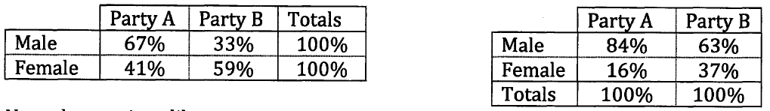
Unit 3 Chapter 1A
We could also consider percentages of the rows (row percentages) and percentages of the columns (column percentages).
The row percentage tells us what proportion of the male and female MPs belongs to each party etc.
The column percentage tells us what proportion of each party’s MPs are male and female.
Now we can state:
Out of the male MPs, 67% are from A.
Out of the female MPs, 59% are from B.
37% of MPs from B are female compared to only 16% from A.

Slide 6
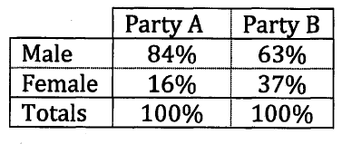
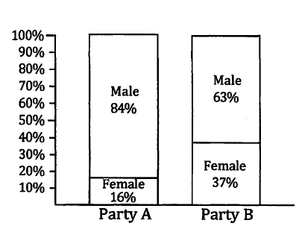
Unit 3 Chapter 1A
We can display this data more visually in a stacked 100% column graph, where we can easily see that as we move from A to B, the male-female proportions change noticeably.
As the proportion of MPs who are female is much greater in B than in A, suggesting there is a relationship between the two categorical variables, Party and Gender of MP.
If there was no relationship, the proportions would not change so noticeably from A to B.

Slide 7
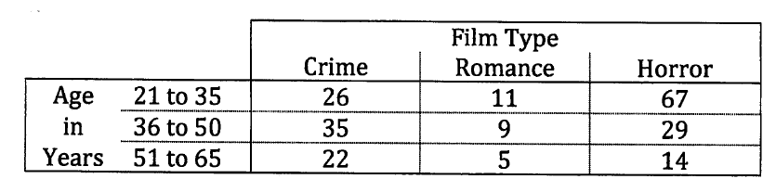
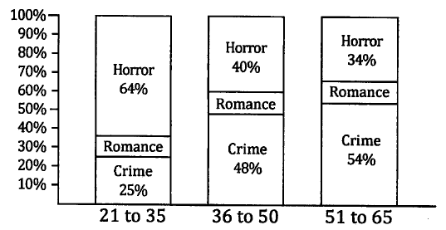
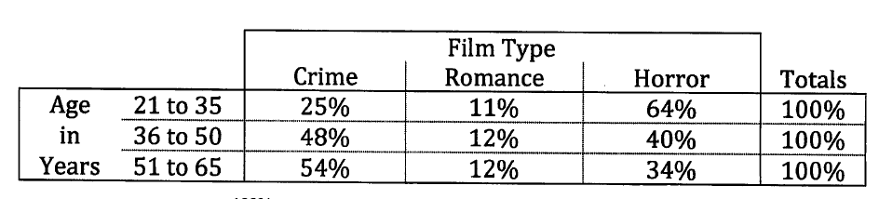
Unit 3 Chapter 1A Example 1
A number of people were asked whether they preferred crime, romance or horror movies best. The data was sorted according the age of the person asked.
a) Draw the frequency table showing row percentages.
b) Draw a proportional column graph for each of the age groups.

Slide 8
Unit 3 Chapter 1A Example 1
A number of people were asked whether they preferred crime, romance or horror movies best. The data was sorted according the age of the person asked.
c) Comment on and describe any association between the variables.
The ages of 36 to 50 and 51 to 65 show similar proportions of preferred genre but there is an obvious difference in the proportions of the first age category to the other two, suggesting there is an association between age and preferred genre.
The percentage of each age category preferring romance films is almost the same.
About 2/3 of 21 to 35 year olds prefer horror movies; whereas only 1/3 of 51 to 65 year old preferred horrors.
This was the opposite of crime movies, where just 1/4 of 21 to 35 year olds preferred them compared to over half of 51 to 65 year olds.

Slide 9
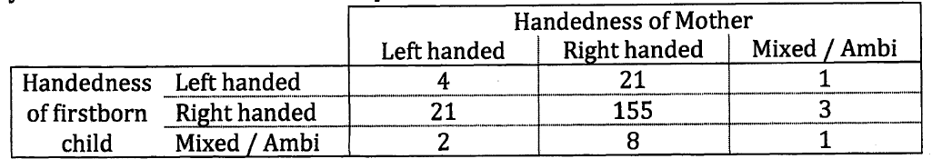
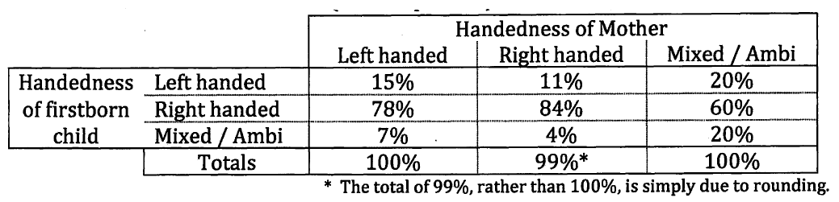
Unit 3 Chapter 1A Example 2
Classifying people as one of three categories (left handed, right handed or ambidextrous), a survey looking at whether the ‘handedness’ of a firstborn child could be explained by the ‘handedness’ of the mother, produced the following.
Draw the above table showing column percentages and use it to identify and describe any patterns shown and whether an association between the handedness of a child and the handedness of the mother is suggested.

Slide 10
Unit 3 Chapter 1A Example 2
Now try Exercise 1A
Draw the above table showing column percentages and use it to identify and describe any patterns shown and whether an association between the handedness of a child and the handedness of the mother is suggested.
The biggest variations are in the ambidextrous column; however the percentages are based on a very small amount of data (5) so this column is limited in its use.
The changes in proportions in the first two columns are not large. There is a greater percentage of right handed mothers whith right handed children (84%) compared to left handed mothers with right handed children (78%) but the difference is only 6%. More left handed mothers had left handed children (15%) than right handed mothers (11%) but again, this is not a large difference.
The table suggests that the handedness of the mother and firstborn child could be associated to a limited extent, but this association is not particularly strong.

